Slide 1


Git & Github
Features
itechart.com

Slide 2
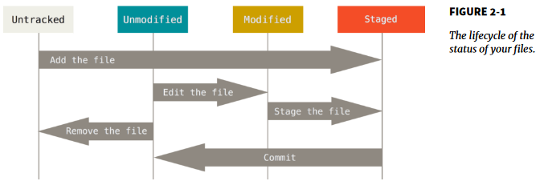
Simple Git Flow
• git init
• git add
• git commit
• git status
• git log
• git <command> --help

Slide 3
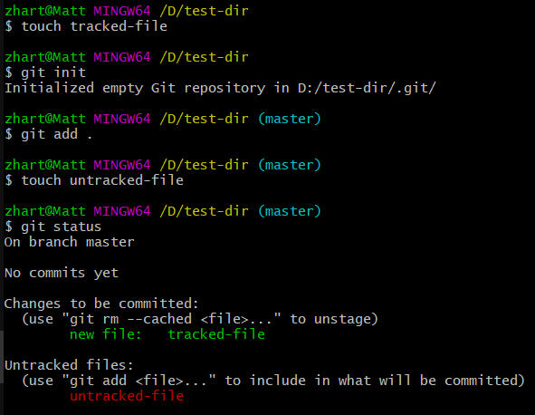

Slide 4
Changes cancelling
• git checkout <hash or branch>
• git reset <hash> [--soft, --mixed, --hard]
• git revert <hash>

Slide 5
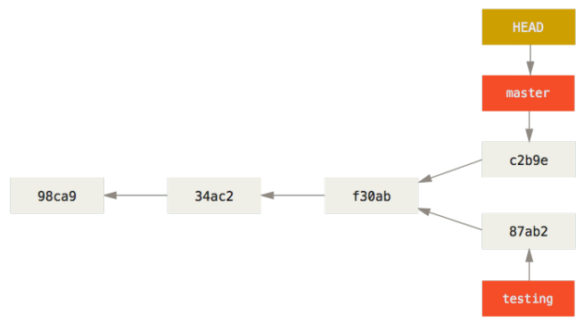
Branches
• git branch <name>
• git checkout <branch>
• git merge <branch>
• git rebase <branch>

Slide 6
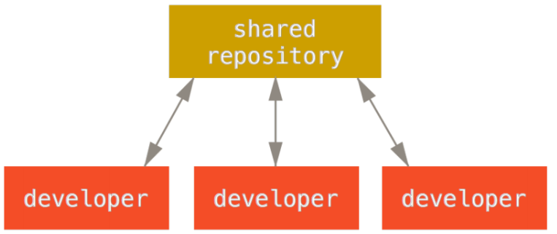
Remote Repository
• git clone
• git fetch
• git push
• git pull (fetch + merge)
• git remote add origin <url>

Slide 7
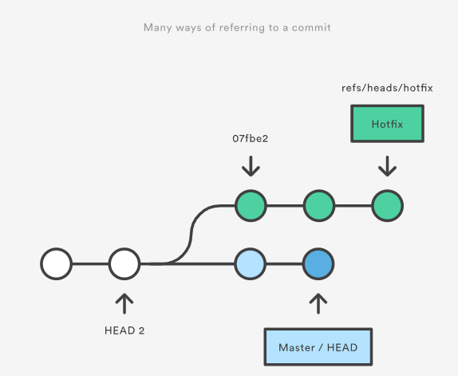
Refs
• Hash
• Branch
• Tag
• HEAD
• etc.

Slide 8
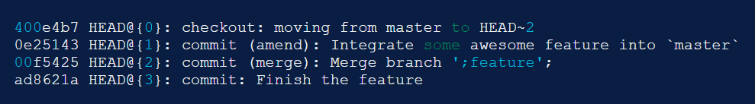
References log
• git reflog
The reflog is Git’s safety net.
Chronological history of everything you’ve done in your local repo.

Slide 9
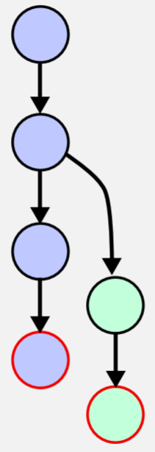
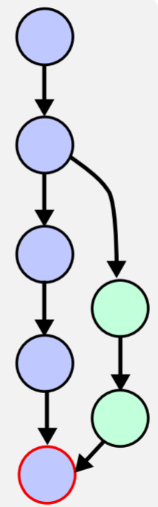
Merge

Slide 10
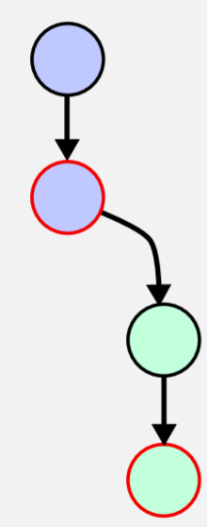
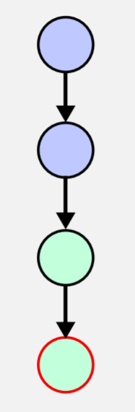
Fast Forward

Slide 11
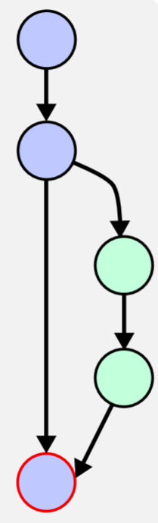
No Fast Forward (--no-ff)

Slide 12
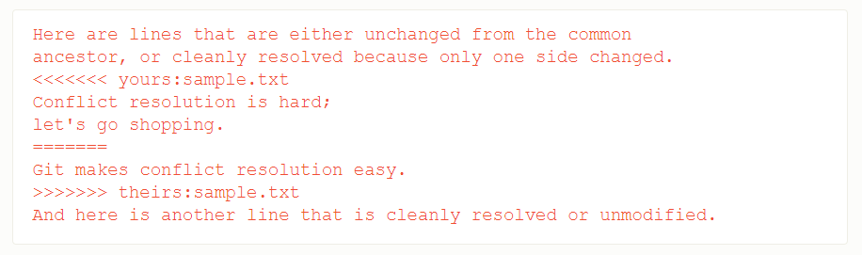
Merge Conflicts
• Edit conflicted files
• Add them to index
• Commit
• git add
• git commit
• git merge --continue

Slide 13
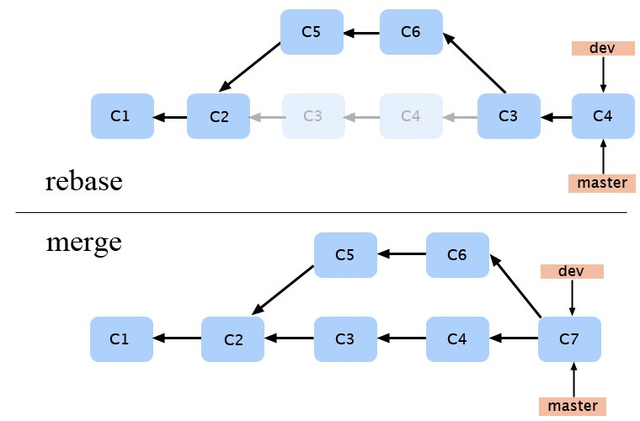
Rebase
• git rebase
• git rebase –onto <base>
• git push -- force

Slide 14
Rewriting History
• git stash
• git commit --ammend
• git rebase –interactive HEAD

Slide 15
.gitignore
• Blank lines or lines starting with # are ignored.
• Standard glob patterns work.
• You can start patterns with a forward slash (/) to avoid recursivity.
• You can end patterns with a forward slash (/) to specify a directory.
• You can negate a pattern by starting it with an exclamation point (!).

Slide 16
.gitignore
• An asterisk (*) - zero or more characters.
• A question mark (?) - a single character
• [abc] - any character inside the brackets
• [0-9] - any character from range
• Two asterisks (**) - nested directories

Slide 17
.gitignore
• 1. --system (C:/ProgramData/Git/.config)
• 2. --global (C:/Users/$USER/.gitconfig)
• 3. config file in the Git directory (.git/config)
• git config --global user.name "John Doe"
• git config --global user.email johndoe@example.com

Slide 18
.gitignore
• core.autocrlf
true checkout Windows-style, commit Unix-style
input checkout as-is, commit Unix-style
false checkout as-is, commit as-is
• credential.helper
feature to avoid inputting git credentials repeatedly

Slide 19
Git Hooks
• client side (pre-commit, post-commit, pre-push, etc.)
• server side (pre-receive, update, post-receive)

Slide 20
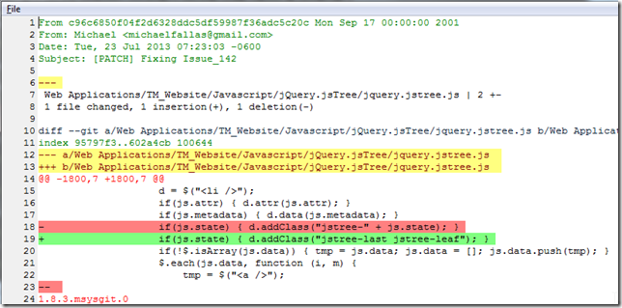
Patch

Slide 21
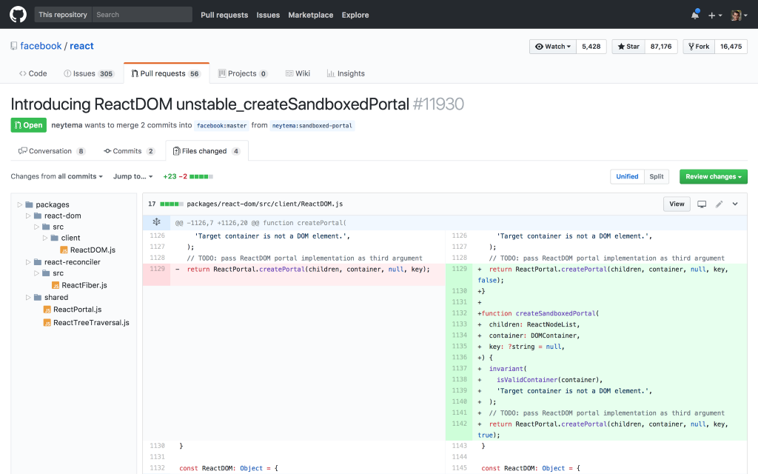
Pull Request
• Notify team
• Discuss and propose
• Collect issues

